Slide 1
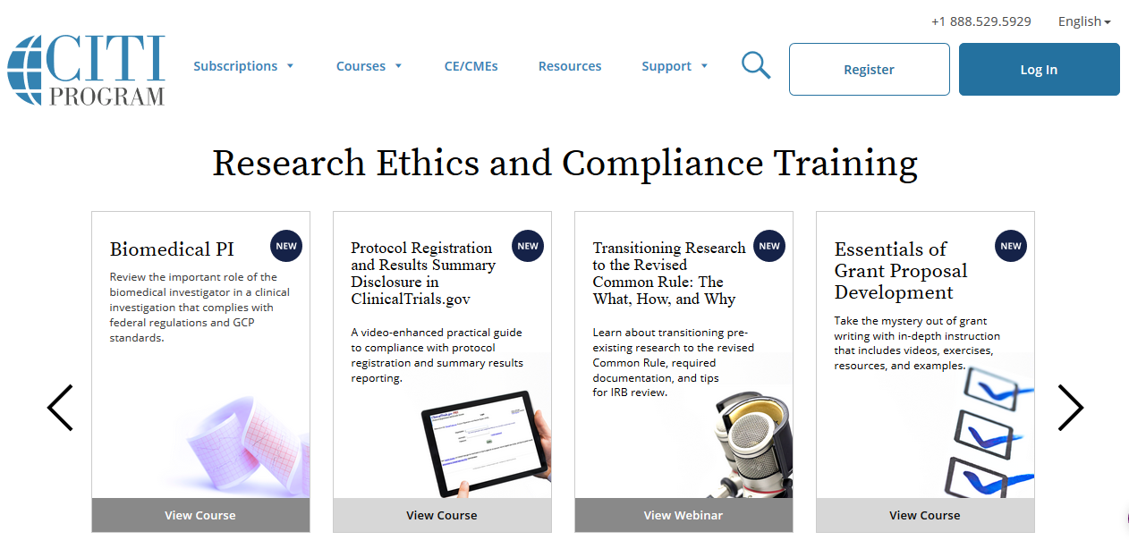



Michael Tran
Major: Computer Science
Year: Starting 4th year undergraduate
Fun Fact: I enjoy cruising on my longboard
Why Am I Here: GPIP Program Under Professor Marai
Project: Basic data visualization with anonymized data of head and neck cancer patients at UIC. We will be doing the data entry and data cleaning
CITI Investigator Training(HSP)
CITI Information Privacy & Security (IPS) HIPAA Training
HTML Tutorials
CSS Tutorials

